Slide 1
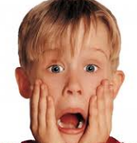
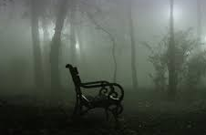
Settler task: Synonyms for “scary”
Review prior learning
Discussing outcomes
Notes:
Discuss devised thematic work. Use a range of stimuli to for students to use, including the Archie Dobson’s War script. Use images and YouTube clips too.

Slide 2
A clause that can form a complete sentence standing alone, having a subject and a predicate.
What is a main clause?
What is a subordinate clause?
A clause, typically introduced by a conjunction, that forms part of and is dependent on a main clause.
Review prior learning
Notes:
Discuss devised thematic work. Use a range of stimuli to for students to use, including the Archie Dobson’s War script. Use images and YouTube clips too.

Slide 3
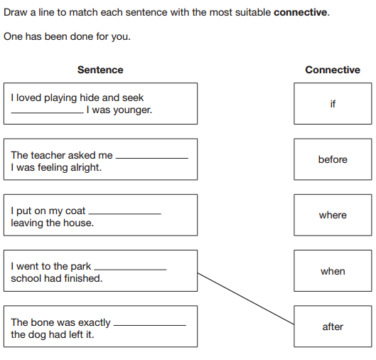
Demonstrate learning

Slide 4
Demonstrate learning

Slide 5
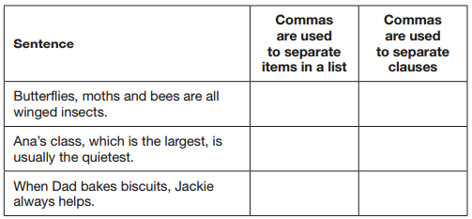
Review learning
Demonstrate learning

Slide 6
Review learning
Demonstrate learning

Slide 7
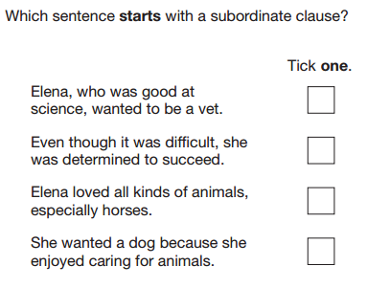
Review learning
Demonstrate learning

Slide 8
Review learning
Demonstrate learning

Slide 9
Review learning
Demonstrate learning

Slide 10
Review learning
Demonstrate learning

Slide 11
Review learning
Demonstrate learning

Slide 12
Review learning
Demonstrate learning
;
,

Slide 13
Review learning
Demonstrate learning

Slide 14
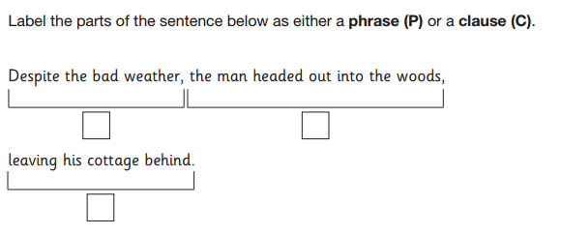
Review learning
Demonstrate learning

Slide 15
Review learning
Demonstrate learning
P
C
C

Slide 16
Main clauses and subordinate clauses
Identify the subordinate clause(s) in the following sentences. Remember they can be at different points in the sentence and add detail to the main clause.
After she picks me up, mum is taking me shopping.
I first met him in France, where I lived as a child.
The summer holidays, when they finally arrive, will be the best time to go.
My grandparents, who live in London, will be visiting for two weeks.
While he slept on the sofa, the dog chewed the leg of the chair.
She refused to eat it, even though she had said that she liked it.
When a six-foot snake slithered across the grass, Lenny gasped.
Sophie was in trouble, unless she finished her homework in the next thirty minutes!

Slide 17
Main clauses and subordinate clauses
Identify the subordinate clause(s) in the following sentences. Remember they can be at different points in the sentence.
After she picks me up, mum is taking me shopping.
I first met him in France, where I lived as a child.
The summer holidays, when they finally arrive, will be the best time to go.
My grandparents, who live in London, will be visiting for two weeks.
While he slept on the sofa, the dog chewed the leg of the chair.
She refused to eat it, even though she had said that she liked it.
When a six-foot snake slithered across the grass, Lenny gasped.
Sophie was in trouble, unless she finished her homework in the next thirty minutes!

Slide 18
Main or subordinate clause?
The following sentences have been divided into clauses, but which is which?
Whenever he calls, she pretends not to be home.
I took a long, deep breath before opening the door.
She hasn’t stopped swimming since she got in the pool.
As he carried his plate into the kitchen Sam tripped on the carpet.
You’re in big trouble when Dad gets home.

Slide 19
Main or subordinate clause?
The following sentences have been divided into clauses, but which is which?
Main clause
Whenever he calls, she pretends not to be home.
I took a long, deep breath before opening the door.
She hasn’t stopped swimming since she got in the pool.
As he carried his plate into the kitchen Sam tripped on the carpet.
You’re in big trouble when Dad gets home.
Subordinate clause
Main clause
Subordinate clause
Main clause
Subordinate clause
Subordinate clause
Main clause
Main clause
Subordinate clause

Slide 20
Using subordinate clauses
Below are some main clauses. Add one or more subordinate clauses to each of them to produce more detailed sentences
For example: The dog barked
As the bell rang, the dog barked, frightening the boys.
This subordinate clause gives detail as to when
This subordinate clause gives detail as to the effect
Main clause
Remember – the main clause can be in different places in the sentence!
Try to add subordinate clauses to these main clauses:
I didn’t sleep well
The boat was sinking
They went to McDonalds
I crept inside
He will be home tomorrow

